Slide 1
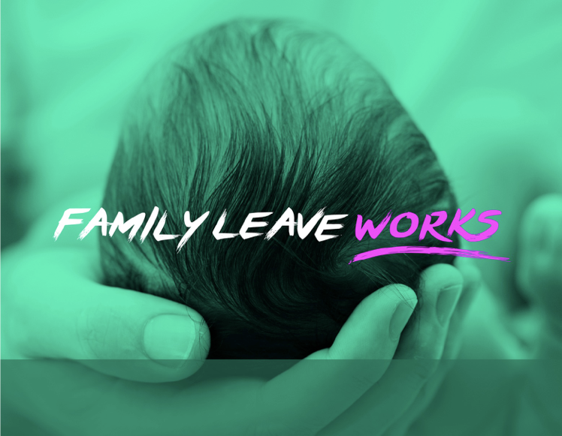

Slide 2

Cornell CLE: What Paid Family Leave Means for New York and the Nation
A Better Balance:
The Work and Family Legal Center
November 29, 2017

Slide 3
A BETTER BALANCE
We are a national legal non-profit, based in New York, that helps working people care for themselves and their families without compromising their economic security through policy advocacy, outreach, and direct legal services.

Slide 4
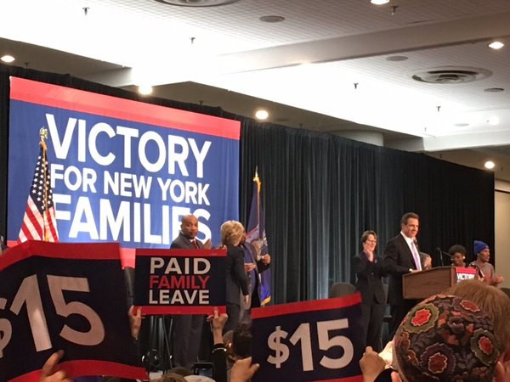
“VICTORY FOR NEW YORK FAMILIES”
On April 4, 2016, Governor Andrew Cuomo signed into law the nation’s leading paid family leave law, a groundbreaking new piece of legislation.

Slide 5
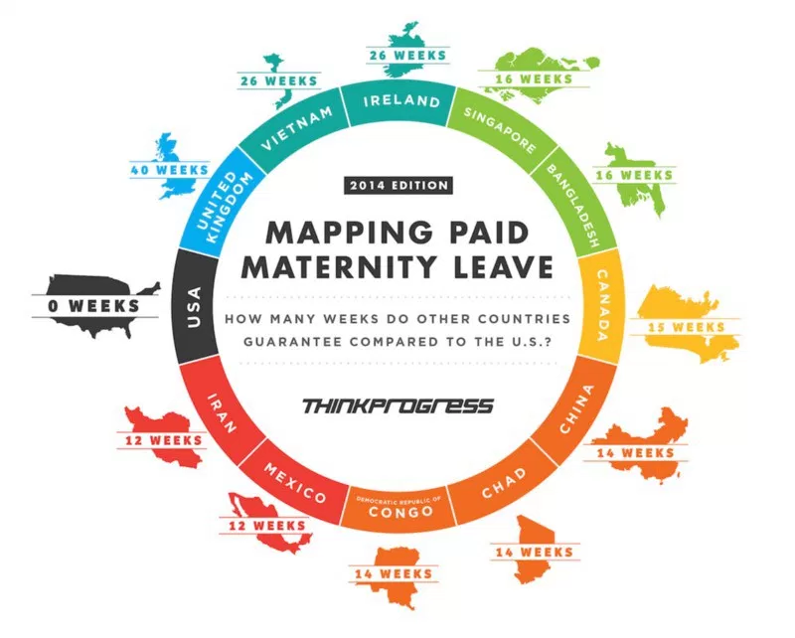

THE NEED FOR LEAVE

Slide 6
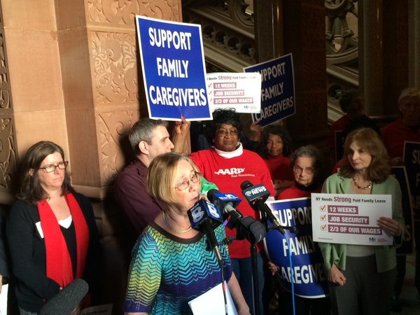
OUR ROLE
We helped to lead the campaign, working tirelessly alongside our partners to ensure that we had the strongest bill possible. At A Better Balance, we served as legal experts to the campaign, educating the public and policymakers about the law. We also organized workers, collected petition signatures, and rallied business leaders.

Slide 7
KEY PARTNERS: STEERING COMMITTEE
We’re proud to have served on the steering committee alongside:
1199 SEIU
32BJ SEIU
Citizen Action of NY
Community Service Society
New York Civil Liberties Union
New York Paid Family Leave Coalition
New York State AFL-CIO
New York Statewide Senior Action Council
Working Families Organization

Slide 8
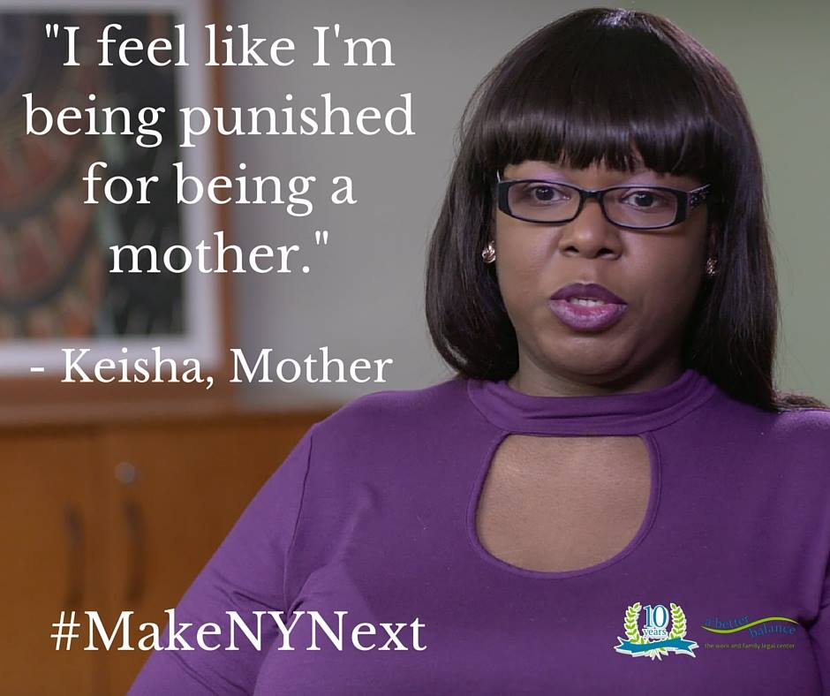
WHAT THIS WIN MEANS FOR NEW YORKERS
The new law will provide critical support for the estimated 6.4 million working New Yorkers like Keisha who currently lack access to paid family leave.
Nationwide, only 12% of workers have access to paid leave.
The FMLA provides only unpaid leave and covers only 60% of workers.

Slide 9

CORE STRATEGY: SHARING WORKER STORIES
Lifting up worker stories drove home the importance of this issue.
Paid family leave is a women’s issue, but it’s also a moral issue and an economic justice issue.
Lack of paid leave affects mothers and fathers, workers caring for seriously ill family members, and military families.

Slide 10

CORE STRATEGY: THE PUBLIC HEALTH CASE
When parents—fathers and mothers; biological, adoptive, and foster—are able to take adequate family leave, their health and their children’s health benefit.
We emphasized the strong body of research showing the health and developmental impacts of paid family leave.

Slide 11
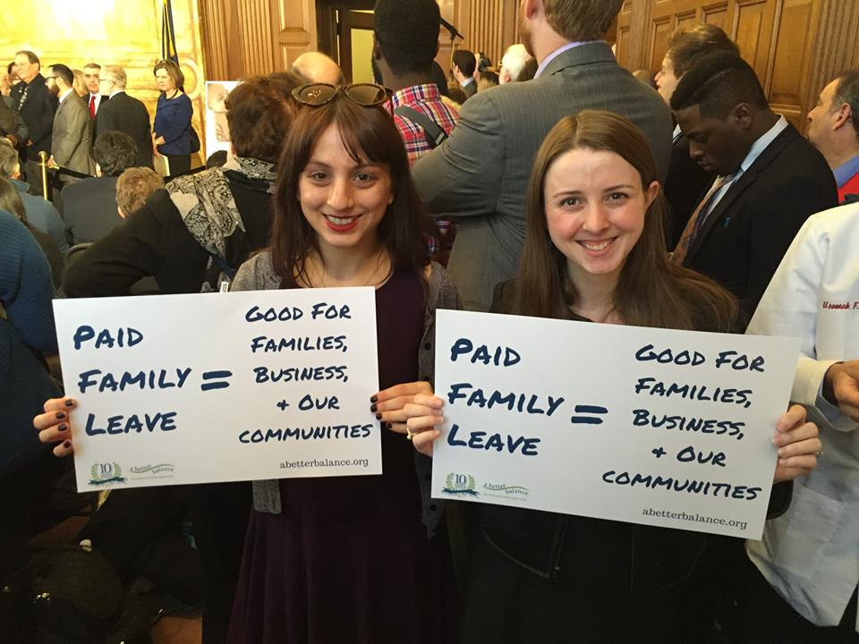
CORE STRATEGY: BUSTING MYTHS
Much of the opposition to paid family leave centered around misinformation or confusion about the program, especially around business impact.
Particularly where we had data from other states about their experiences, we corrected the record with the real story.

Slide 12
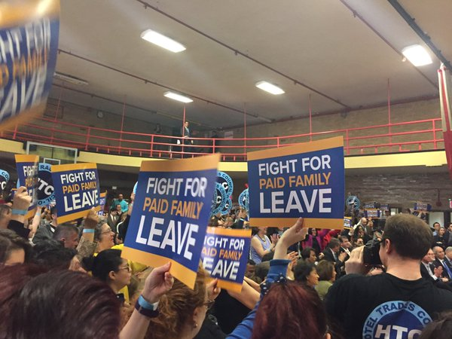
PAID FAMILY LEAVE: NUTS & BOLTS

Slide 13
NEW YORK PAID FAMILY LEAVE
New York’s paid family leave law was signed on April 4, 2016.
Benefits begin under the law on January 1, 2018.

Slide 14
BACKGROUND: TEMPORARY DISABILITY INSURANCE
The paid family law builds on the state’s temporary disability insurance (TDI) law.
TDI has been in place since 1949 and provides wage replacement to workers unable to work due to serious off-the-job illness or injury.
Though paid family leave is built on TDI, the two programs are not identical and sometimes follow different rules.

Slide 15
WHO IS COVERED?
Almost all private sector employees in New York are covered.
Full-time and part-time employees are covered.
There is no minimum number of employees.
Employees are covered regardless of citizenship or immigration status.

Slide 16
WHEN DO WORKERS BECOME ELIGIBLE?
Most workers will be eligible for leave when they have been employed for 26 weeks (about 6 months).
Part-time workers who work less than 20 hours per week will need to work for 175 days in order to be eligible.

Slide 17
VOLUNTARY COVERAGE
Almost all employers who are not required to provide coverage can choose to do so voluntarily.
Self-employed individuals can opt in to coverage.
Public sector employers can opt in to coverage and public sector unions can negotiate to opt in to coverage through the bargaining process.

Slide 18
PURPOSES OF LEAVE
Workers will be able to take leave to:
Bond with a new child (including foster & adopted children)
Care for a family member with a serious health condition
Address certain military family needs

Slide 19
NUMBER OF WEEKS
The program phases in over four years, with the number of weeks of paid family leave workers can take going up over time.
2018: Up to eight weeks
2019 & 2020: Up to ten weeks
2021 & on: Up to twelve weeks

Slide 20
BENEFIT LEVEL
In 2018, workers will receive 50% of their own wages (about half of their regular paycheck), up to about $650/week.
In subsequent years, both the wage replacement rate (the percentage of their own wages workers receive) and the cap will increase.
When the program is fully phased in in 2021, workers will receive 67% of their own wages (about 2/3 of their regular paycheck), up to a cap.

Slide 21
JOB PROTECTION
Under the law, all covered workers will be entitled to return to work after taking leave and continuation of health insurance while they are on leave.

Slide 22
KEY DIFFERENCES BETWEEN TDI & PFL
Unlike paid family leave, TDI:
Covers workers’ own health
Benefits are 50% of workers’ own wages, up to a maximum of $170/week
No job protection or continuation of health insurance

Slide 23

TYPES OF LEAVE

Slide 24
BONDING LEAVE
A parent of any gender can take bonding leave within 12 months of a child’s birth or placement for adoption or foster care.
Parents who welcome a new child before January 1, 2018 can take paid family leave after January 1, so long as leave is taken within 12 months of birth or placement.

Slide 25
BONDING LEAVE & TDI
Under existing law, covered workers can receive TDI benefits while recovering from childbirth.
A parent who gives birth can take both TDI to recover from childbirth and paid family leave for bonding, but may not take both at the same time.
Different choices may make sense for different workers.

Slide 26
FAMILY CARE LEAVE
Family care leave be taken to care for a covered family member who has a serious health condition.

Slide 27
COVERED FAMILY MEMBERS
Family care leave can be taken to care for a worker’s:
Child
Spouse
Parent (including parent-in-law)
Grandparent
Grandchild
Spouse
Domestic Partner

Slide 28
SERIOUS HEALTH CONDITION
A serious health condition is a physical or mental illness, injury, or condition that requires either
Inpatient care or
Ongoing treatment or supervision by a healthcare provider

Slide 29
SERIOUS HEALTH CONDITION (continued)
Serious health conditions can include:
Serious mental health conditions
Chronic conditions (e.g. asthma or diabetes)
Conditions for which treatment may not be effective (e.g. Alzheimer’s or a terminal disease)
Serious conditions do not include ordinary illnesses like the flu, a cold, or an upset stomach.

Slide 30
MILITARY FAMILIES LEAVE
Military families leave can be taken be taken for a “qualifying exigency” when a covered family member is on active duty abroad or has been notified of an impending call or order to active duty abroad.

Slide 31

FUNDING & ACQUIRING COVERAGE

Slide 32
FUNDING
Paid family leave is 100% employee-funded through payroll deductions.
2018 maximum deduction: 0.126% of wages, up to $1.65/week
Employers are permitted, but not required, to begin withholding contributions before January 1.

Slide 33
HOW TO ACQUIRE COVERAGE
Employers can acquire coverage that meets their legal obligations in three main ways:
By purchasing insurance from the state (SIF)
By purchasing insurance from a private carrier
By becoming an approved self-insurer

Slide 34
MAINTAINING COVERAGE
Failure to maintain coverage is a criminal offense subject to severe fines and potential imprisonment of up to a year.

Slide 35

EMPLOYEE RIGHTS

Slide 36
EMPLOYEE RIGHTS
Employees have three main rights relative to their employer under the paid family leave law.
All three rights can be enforced through administrative proceedings at the Workers’ Compensation Board.

Slide 37
NON-RETALIATION
Employees have the right not to be retaliated against or discriminated against for exercising their rights (including the right to take leave) under the paid family leave law.

Slide 38
JOB PROTECTION
Employees also have the affirmative right to be restored to either their prior job or “a comparable position with comparable employment benefits, pay and other terms and conditions of employment.”

Slide 39
CONTINUATION OF HEALTH INSURANCE
Employees who receive health insurance through their employers have the right to continuation of health insurance on the same terms as if the employee had continued working.

Slide 40

NOTICE & APPLICATION PROCESS

Slide 41
EMPLOYEE NOTICE
If possible, employees must give notice to their employers at least 30 days in advance of a foreseeable use of paid family leave.
If that is not possible, employees must give notice “as soon as practicable.”
No “magic words” requirement

Slide 42
APPLYING FOR BENEFITS
Employees will submit applications to the employer’s paid family leave insurance carrier (or the self-insured employer).
This application will include appropriate documentation of the need for leave, as required by the state.

Slide 43
PROCESSING & DISPUTED CLAIMS
The insurance carrier (or self-insured employer) must pay or deny a completed claim within 18 days.
Disputes with an insurance carrier (or self-insured employer acting as an insurance carrier) regarding “eligibility, benefit rate, and duration of paid family leave” are subject to arbitration.

Slide 44
FOR MORE INFORMATION
dbakst@abetterbalance.org
Visit our website at FamilyLeaveWorks.org or call 1-833-NEED-ABB.

Slide 45


Cornell ILR Panel
November 29, 2017

Slide 46
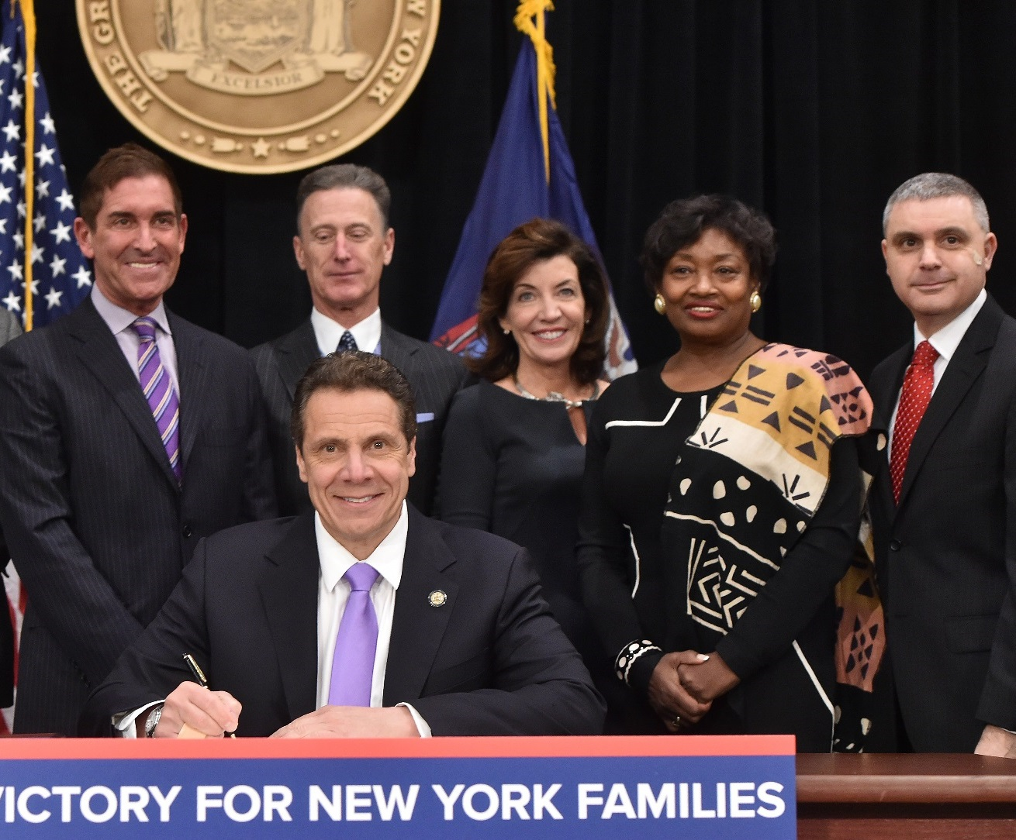

New York Leads the Nation
In April 2016,
Governor Cuomo signed the nation’s strongest and most comprehensive Paid Family Leave policy into law
Helpline: (844) 337-6303 Website: www.ny.gov/PaidFamilyLeave

Slide 47

Agenda
Paid Family Leave Basics
Public Employers
Private Employers with Unionized Employees
Enforcement
How PFL Works
Helpline: (844) 337-6303 Website: www.ny.gov/PaidFamilyLeave

Slide 48

4
Paid
Family Leave
Basics
Helpline: (844) 337-6303 Website: www.ny.gov/PaidFamilyLeave

Slide 49




What is Paid Family Leave?
It provides Paid Time Off and Job Protection for
Bonding with a child
    Caring for sick family members
    Assisting family when a service member is deployed abroad
Helpline: (844) 337-6303 Website: www.ny.gov/PaidFamilyLeave

Slide 50

Who is Eligible?
Employees are eligible if they regularly work:
    20 or more hours per week
      For 26 consecutive weeks
    Less than 20 hours per week
      For 175 days
Employees are eligible regardless of citizenship
Helpline: (844) 337-6303 Website: www.ny.gov/PaidFamilyLeave

Slide 51

How is PFL Funded?
PFL will be fully funded by employee contributions
For 2018:
Employee contributions are 0.126% of an employee’s weekly wage capped at the New York State Average Weekly Wage
The maximum employee contribution is $1.65/week
Helpline: (844) 337-6303 Website: www.ny.gov/PaidFamilyLeave

Slide 52

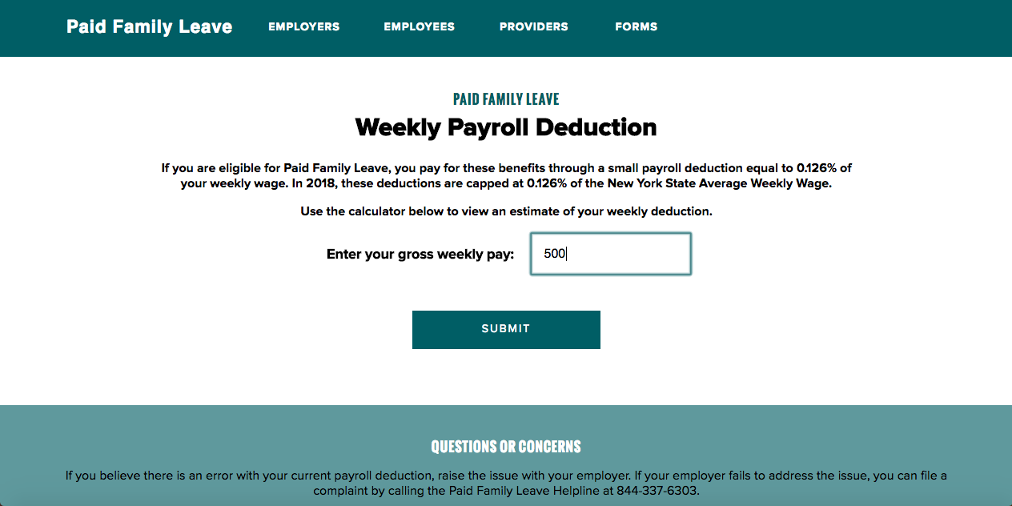
Payroll Deduction Calculator
Helpline: (844) 337-6303 Website: www.ny.gov/PaidFamilyLeave

Slide 53
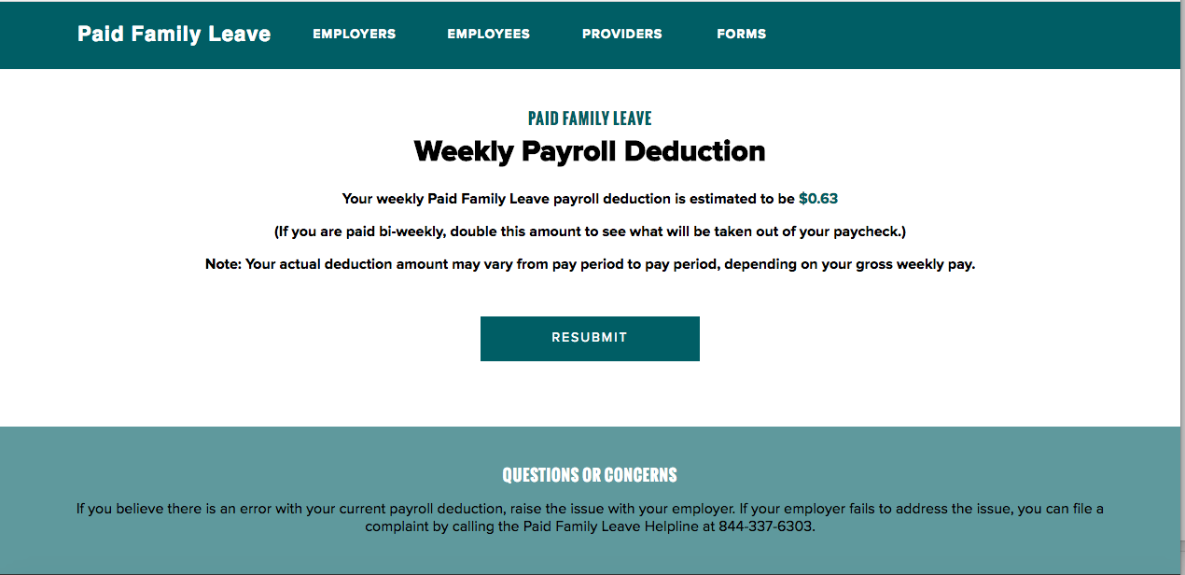
Payroll Deduction Calculator
Helpline: (844) 337-6303 Website: www.ny.gov/PaidFamilyLeave

Slide 54
Wage Benefits
Benefits phase in starting January 1, 2018 at 50% of an employee’s
average weekly wage and will reach 67% by 2021
67%
60%
55%
50%
2018
2019
2020
2021
* Benefits will be capped at the designated percentage of the statewide average weekly wage.
Helpline: (844) 337-6303 Website: www.ny.gov/PaidFamilyLeave

Slide 55

Examples for 2018 PFL Coverage
Weekly Salary | Weekly PFL contribution | Maximum PFL Time Off | Weekly Pay on PFL | Maximum Paid Benefit
$500 ($26,000 annually) | $0.63/week ($32.67 annually) | 8 weeks | $250 | $2000
$1305.92 ($68,907 annually) | $1.65/week ($85.56 annually) | 8 weeks | $652.96 | $5223.68
Helpline: (844) 337-6303 Website: www.ny.gov/PaidFamilyLeave

Slide 56

Time Off Benefits
Time off benefits phase in starting January 1, 2018 at 8 weeks
and will reach 12 weeks by 2021
12
WEEKS
10
WEEKS
10
WEEKS
8
WEEKS
2018
2019
2020
2021
* The Department of Financial Services will review the marketplace every year before benefits are increased.
Helpline: (844) 337-6303 Website: www.ny.gov/PaidFamilyLeave

Slide 57

Employee Protections
Employees have paid time off and:
Job Protection
Health insurance continued while on leave
    Employees continue paying their share, if any
Protection from discrimination and retaliation for taking or inquiring about PFL
Helpline: (844) 337-6303 Website: www.ny.gov/PaidFamilyLeave

Slide 58
How are PFL & FMLA similar?
  Leave for the same events
    Bonding with a child
    Caring for sick family members
    Assisting family when a service member is deployed abroad
  Job protection
  Continued health insurance
Helpline: (844) 337-6303 Website: www.ny.gov/PaidFamilyLeave

Slide 59
How are PFL & FMLA different?
 | New York State Paid Family Leave | FMLA
Benefit | Paid | Unpaid
Coverage | All private employers, but public employers can opt in One or more employees in any calendar year | All private and public employers 50 or more employees in a 75-mile radius
Eligibility | After 26 consecutive weeks of employment, or If less than 20 hours a week, after working 175 days | 12 months of employment, and 1,250 hours of work in the 12-month period preceding leave
Reason for Leave | Employees cannot use for own serious health condition Can be used to care for a child of any age | Employee can use for own serious health condition. Can only be used to care for a child if the child is under 18 years old, or “incapable of self-care because of a mental or physical disability”
Paid Time Off | Employers cannot force employees to use paid time off (e.g. vacation time) while on PFL | Employers can compel an employee to use paid time off (e.g. vacation time) while on FMLA
Helpline: (844) 337-6303 Website: www.ny.gov/PaidFamilyLeave

Slide 60
Other States with Paid Family Leave
 | New York | California | New Jersey | Rhode Island | Washington* | D.C.*
Health Insurance | YES | NO | NO | YES | NO | NO
Job Protection | YES | For businesses of 50 or more | For businesses of 50 or more | YES | For businesses of 50 or more | For businesses of 20 or more
Discrimination Prohibited | YES | For businesses of 50 or more | For businesses of 50 or more | For businesses of 50 or more | YES | YES
Structure | Private Insurance | Administered by the State | Administered by the State, some private plans | Administered by the State | Administered by the State | Administered by the State
Length of Leave (fully implemented) | 12 weeks | 6 weeks | 6 weeks | 4 weeks | 12 weeks | 8 weeks bonding, 6 weeks family care, 2 weeks self care
Waiting Period | NO | 7 days | 7 days | NO | For bonding leave NO, family care YES | 1 week per year without pay
Military Exigency Included | YES | NO | NO | NO | YES | NO
* Anticipated implementation in 2020.
Helpline: (844) 337-6303 Website: www.ny.gov/PaidFamilyLeave

Slide 61
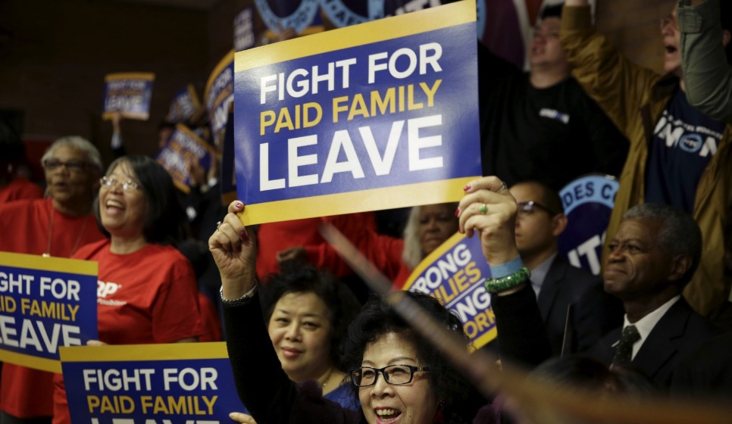
Obtaining Coverage
  Employers provide PFL via
    an insurance policy or
    self-insurance
  Employers who self-insure for disability benefits may
    apply to self-insure for PFL as well or
    purchase a stand-alone PFL insurance policy.
Helpline: (844) 337-6303 Website: www.ny.gov/PaidFamilyLeave

Slide 62

Public Employers
Helpline: (844) 337-6303 Website: www.ny.gov/PaidFamilyLeave

Slide 63
Public Employers
  Public employers have the option to provide Paid Family Leave
  Public employers currently providing disability benefits
    Must notify its employees and the Board by December 1, 2017 whether or not it is offering PFL in 2018
  If a public employer does not opt in by January 1, 2018, it can opt in later at any time
Helpline: (844) 337-6303 Website: www.ny.gov/PaidFamilyLeave

Slide 64
Public Employees
  Participation of employees represented by a union
    Subject to negotiation
  Participation of employees not represented by a union
    Not subject to negotiation
    Employers unilaterally choose whether to opt in
Helpline: (844) 337-6303 Website: www.ny.gov/PaidFamilyLeave

Slide 65
Public Employers with Unionized Employees
  Any agreement must provide benefits at least as favorable as the statutory PFL benefits
  Agreements must be submitted to the Board
Helpline: (844) 337-6303 Website: www.ny.gov/PaidFamilyLeave

Slide 66
Public Employer Notifications
  Opting-In
    Public employers must give 90 days’ notice prior to taking deductions from employees
  Stopping PFL Benefits
    Coverage may be discontinued on 12 months’ notice to those employees
Helpline: (844) 337-6303 Website: www.ny.gov/PaidFamilyLeave

Slide 67
Private Employers with a Unionized Workforce
Helpline: (844) 337-6303 Website: www.ny.gov/PaidFamilyLeave

Slide 68
Private Employers with Unionized Employees
  Private employers with represented employees must have PFL coverage.
  PFL benefits can be provided:
    As a rider on a current disability policy
    By purchasing a standalone PFL policy if self-insured for disability or if the union provides disability and will not provide PFL
    By collectively bargaining with the private union(s) with benefits as least as favorable as the statutory provisions
Helpline: (844) 337-6303 Website: www.ny.gov/PaidFamilyLeave

Slide 69
Private Unions Providing PFL Coverage
  Private unions may collectively bargain for paid family leave benefits
  If benefits are “at least as favorable”
    An employer can use that plan as the required coverage
    Subject to Board review and approval
Helpline: (844) 337-6303 Website: www.ny.gov/PaidFamilyLeave

Slide 70
Review of Private Union Providing PFL Coverage
  Union submits an application (DB-801) and the agreement to the Board for review.
  After WCB approval, the union and each participating employer completes DB-802 to use union plan as required statutory PFL coverage
  The WCB Plan Acceptance Unit provides assistance throughout the process
Helpline: (844) 337-6303 Website: www.ny.gov/PaidFamilyLeave

Slide 71
4
Enforcement
Helpline: (844) 337-6303 Website: www.ny.gov/PaidFamilyLeave

Slide 72
Compliance
  Covered employers must have PFL coverage in place by January 1, 2018
  Penalties for non-compliance are found in Section 220 of the WCL
Helpline: (844) 337-6303 Website: www.ny.gov/PaidFamilyLeave

Slide 73
Uninsured Claims
  If an employer has failed to obtained PFL coverage
    Employees apply to the Board for PFL benefit
    Claims are:
      Processed by the Board, and
      Paid by the Special Fund for Disability Benefits
    Board subrogates against the uninsured employer
Helpline: (844) 337-6303 Website: www.ny.gov/PaidFamilyLeave

Slide 74
4
Dispute Resolution
Helpline: (844) 337-6303 Website: www.ny.gov/PaidFamilyLeave

Slide 75
Disputing PFL Carrier Claim Denials
  Denial can be disputed if :
    carrier is rejecting the claim, or
    coverage is disputed.
  Any party can request review through arbitration
Helpline: (844) 337-6303 Website: www.ny.gov/PaidFamilyLeave

Slide 76
Carrier denials of claims; 380-5.4(b),(d):
  The failure of the employer to adequately or fully complete its portion of the claim is not a valid basis for carrier denial
  Denials without prejudice
    Incomplete claim package
    Insufficient certification or proof of eligibility
Helpline: (844) 337-6303 Website: www.ny.gov/PaidFamilyLeave

Slide 77
Carrier denials of claims; 380-5.4(b),(d):
  Denial reasons
    Eligibility (Insufficient length of employment)
    Not an employee
    Not a covered employment
    Not a covered family member
    Exceeds statutory maximum leave
Helpline: (844) 337-6303 Website: www.ny.gov/PaidFamilyLeave

Slide 78
Carrier denials of claims; 380-5.4(b),(d):
  Denial reasons
    Family leave requested exceeds maximum available
    Failure to provide foreseeable notice (partial denial of initial 30 days)
    Domestic violence perpetrator
    Untimely claim
Helpline: (844) 337-6303 Website: www.ny.gov/PaidFamilyLeave

Slide 79
Carrier denials of claims; 380-5.4(b),(d):
  Denial reasons
    Employer did not have coverage on date leave commenced
    Carrier identified by Board must pay without prejudice while dispute is pending
    Carrier, if denying coverage, has to provide Board with copy of denial
Helpline: (844) 337-6303 Website: www.ny.gov/PaidFamilyLeave

Slide 80
Carrier denials of claims; 380-5.4(b),(d):
  Denial reasons
    Employer did not have coverage on date leave commenced
    Carrier identified by Board must pay without prejudice while dispute is pending
    Carrier, if denying coverage, has to provide Board with copy of denial
Helpline: (844) 337-6303 Website: www.ny.gov/PaidFamilyLeave

Slide 81
Arbitration of Claim Disputes
  Initiating party submits a request for arbitration with a $25 filing fee
  Responding party has 14 days from the receipt of completed request to submit response
  Arbitrator makes a decision in writing within 14 days of submission of all evidence
Helpline: (844) 337-6303 Website: www.ny.gov/PaidFamilyLeave

Slide 82
Arbitration of Claim Disputes
  Arbitration fee paid by:
    The carrier,
    Self-insured employer, or
    The Board, if applicable.
Helpline: (844) 337-6303 Website: www.ny.gov/PaidFamilyLeave

Slide 83
Protection from Discrimination
  Employees can file a discrimination complaint if an employer:
    fires,
    refuses to reinstate to same or similar position,
    reduces pay and/or benefits, or
    disciplines an employee for requesting or taking PFL.
  Cases are adjudicated by the Board.
Helpline: (844) 337-6303 Website: www.ny.gov/PaidFamilyLeave

Slide 84
Discrimination Claims
  Employee sends employer and the Board a request for job reinstatement (PFL-DC-119)
  Employer has 30 days to respond
  If the employee is not satisfied, the employee can file a discrimination complaint (PFL-DC-120)
  A hearing will be scheduled (within 45 days)
Helpline: (844) 337-6303 Website: www.ny.gov/PaidFamilyLeave

Slide 85
Differences from NYS Human Rights Law
 | Applies to: | Type of discrimination prevented | Filing claim | Time period
Human Rights Law | Employers with 4 or more employees | Race, sex, age, marital status, pregnancy-related condition, familial status, etc. | If employee was discriminated against on the basis of a protected group | One year from alleged discrimination
Paid Family Leave | Private employers with 1 or more employees Public employers who opted in | Retaliation for taking or attempting to take PFL | If employer refuses to reinstate or disciplines an employee for taking or attempting to take PFL | Two years from alleged discrimination

Slide 86

How PFL
Works
Helpline: (844) 337-6303 Website: www.ny.gov/PaidFamilyLeave

Slide 87
Employee
Notifies employer of the need for PFL 30 days in advance, if foreseeable
Employee
Files claim form with employer
Employer
Enters information onto claim form
Employee
Attaches supporting documentation
Returns to employee within 3 days
Submits to the insurer
How Employees File a Claim
Insurers must pay or deny the claim within 18 days of receipt
Helpline: (844) 337-6303 Website: www.ny.gov/PaidFamilyLeave

Slide 88

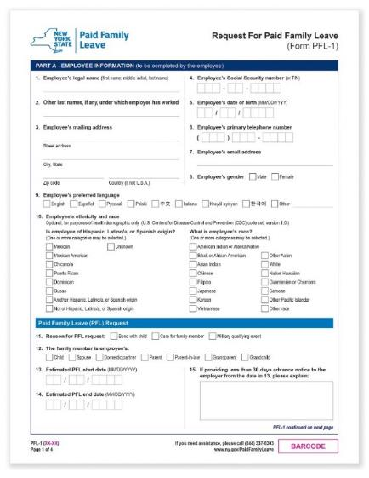
PFL Request Forms
WCB published model request forms for employees, employers and health care providers.
Forms will be available to employees from:
  Employer
  Employer’s insurance carrier
  NY.gov/PaidFamilyLeave
Helpline: (844) 337-6303 Website: www.ny.gov/PaidFamilyLeave

Slide 89

Employer Checklist
Contact your insurance broker about obtaining PFL insurance
Update payroll processes
Inform employees who will likely not qualify for PFL of their option to waive coverage
Helpline: (844) 337-6303 Website: www.ny.gov/PaidFamilyLeave

Slide 90
Employer Checklist
Update written employee materials with PFL information
Post the employee notice provided by your insurer
Helpline: (844) 337-6303 Website: www.ny.gov/PaidFamilyLeave

Slide 91
Employer Resources
Resources available at ny.gov/PaidFamilyLeave include:
Model employee handbook language
PFL waiver forms
PFL request forms
Payroll deduction calculator
WCB Advocate for Business:
1-877-632-4996
advocatebusiness@wcb.ny.gov
Helpline: (844) 337-6303 Website: www.ny.gov/PaidFamilyLeave

Slide 92
More Information
Helpline:
(844) 337-6303
Website:
ny.gov/PaidFamilyLeave

Slide 93
New York Paid Family Leave Benefits Law
Cornell ILR NYC Conference Center
16 East 34th Street, 6th floor
New York, NY
November 29, 2017
Howard Lavin
Partner

Slide 94
Covered Employers/Employees
Effective January 1, 2018, virtually all employers in New York State will be required to provide Paid Family Leave to their employees
  Employers with at least 1 employee
    As a rule of thumb, employees covered by New York State Short Term Disability benefits will be eligible to receive Paid Family Leave starting next year
  Employers of domestic employees who work at least 40 hours per week
  Public employers may opt-in
Out-of-state employer with employees working in New York State for 30 or more days in a calendar year
  Includes employees who “work from home” in New York State, even if the employer is in a different state
  Employees who occasionally travel to New York State are not covered

Slide 95
Qualifying Events for Job-Protected Paid Leave
Bond with a new child during first 12 months after:
  Giving birth
  Placement of a child for adoption or foster care (including events leading up to placement)
  Available without regard to gender of parent
Care for loved ones with a serious health condition
Help relieve family pressures when someone is called to active military service

Slide 96
Amount of Benefit
Phased in over time
2018 maximum benefit: $652.96 per week; no elimination or waiting period
Funded through employee contributions (although employer has option to pay)
  Payroll deduction
  2018: 0.126% of employee’s weekly wage, up to annualized state average weekly wage
  2018 maximum weekly deduction: $1.65
Year | Max weeks | % of employee’s average weekly wage | Capped at a % of state average weekly wage
2018 | 8 | 50 | 50
2019 | 10 | 55 | 55
2020 | 10 | 60 | 60
2021 | 12 | 67 | 67

Slide 97
Tax Implications
Premiums
  Deducted from after-tax wages
  Should be reported on form W-2, Box 14 “State disability insurance taxes withheld”
Benefits
  Taxable non-wage income that must be included in federal gross income
  Taxes will not automatically be withheld from benefits, but employees can request voluntary tax withholding
  Reported by the State Insurance Fund on Form 1099-G and by all other payers on Form 1099-MISC

Slide 98
What is Stroock Telling its Clients?
Think of Paid Family Leave as an insurance benefit
  Augments FMLA for those employers covered by FMLA
  Small employers, not covered by FMLA, will be required to provide job-protected leave
Call your insurance carrier (or broker) that already provides short term disability benefits (typically Paid Family Leave will be an add-on)
Self-insurance is possible
  Deadline to file for 2018, however, has passed (September 30, 2017)
  Employers that self-insure short term disability can purchase a separate Paid Family Leave policy

Slide 99
What is Stroock Telling its Clients (cont.)?
Post Notice: Employers are required to post many notices, including:
  Workers’ Compensation and Short Term Disability Notice of Compliance
  Paid Family Leave Notice of Compliance (provided by insurance carrier or for self-insured, Workers’ Compensation Board)
  Includes rights and obligations
Under New York State Labor Law, employers are required to provide notice to employees, in writing, regarding:
  Sick Leave
  Vacation and Personal Leave
  Holidays and Hours
Promulgate Policy: Most employers provide notice in Employee Handbook
  Revise Employee Handbook to include Paid Family Leave policy
  If no Employee Handbook, issue stand alone policy

Slide 100
  Paid Family Leave vs. Family Medical Leave Act
Issue | FMLA | PFL
Covered Employers | Private employers with 50 or more employees within 75 miles of employee’s worksite | All private employers with 1 or more employees
Covered Employees | 12 months, at least 1,250 hours (only count hours actually worked) | Employees regularly scheduled to work 20 hours or more per week are covered after 26 weeks Employees regularly scheduled to work less than 20 hours per week are covered after 175 days of work Excluded employees may opt to waive coverage, but within 8 weeks of schedule change waiver deemed revoked and required to contribute retroactively

Slide 101
Paid Family Leave vs. Family Medical Leave Act (cont.)
Issue | FMLA | PFL
Covered Employees (cont.) | When calculating the 1,250 hours, only count hours actually worked count | When calculating the 26 weeks and 175 days, approved vacation, sick, personal, PTO or other time away counts, provided that the employee contributes to PFL benefit Periods of temporary disability which are covered under New York State Short Term Disability Benefits Law are not counted

Slide 102
Paid Family Leave vs. Family Medical Leave Act (cont.)
Issue | FMLA | PFL
Qualifying Reason | Employee’s own serious health condition; child bonding; care for a family member with a serious health condition; spouse parent or child called to active duty | Effectively, FMLA-qualifying reasons, excluding employee’s own serious health condition
Covered Family Members | Spouse (not domestic partner); parent (not “in-law”); child (not child of domestic partner) | Spouse (including domestic partner), parent (including “in-law”), child (including child of domestic partner), grandparent, grandchild
Both Spouses Working for the Same Employer | May be limited to 12 weeks combined for child bonding | Both spouses entitled to full amount of leave but may be restricted from taking at the same time for care of same family member or child bonding

Slide 103
Paid Family Leave vs. Family Medical Leave Act (cont.)
Issue | FMLA | PFL
Compensation | Unpaid but employee may substitute available paid leave | Paid benefit equal to a portion of weekly wages based on above schedule Substitution of paid leave depends on circumstances
Interplay with Other Paid Leave | Employee may elect or employer may require substitution of eligible, accrued paid time off, which will run concurrently | When designated concurrently with FMLA, use of eligible, accrued paid time off may be governed by FMLA rules When not designated con-currently, employee may elect (but may not be required) to use accrued paid time off and receive full salary

Slide 104
Paid Family Leave vs. Family Medical Leave Act (cont.)
Issue | FMLA | PFL
Who determines eligibility | Employer | Insurer within 18 days of filing a complete claim for benefits Dispute resolution procedure discussed below
Interplay with Disability Benefits | May run concurrently with Short Term Disability or Workers’ Compensation | May not run concurrently Employee is entitled to combined 26 weeks during 52-week period
Calculating 12-month/52-week period | Employer option: calendar year, any fixed 12-month period, whether measured forward or “rolling backwards” | By law and regulation, calculated retroactively from each day benefit is being claimed–that is, effectively “rolling backwards” calculation

Slide 105
Paid Family Leave vs. Family Medical Leave Act (cont.)
Issue | FMLA | PFL
Employee Notice Obligations | When foreseeable, 30 days’ notice Otherwise, as soon as practicable—typically within 2 business days | Same, provided that Request for Family Leave Form includes section to be completed by employer and returned to insurance carrier within 3 business days
Intermittent Leave | When medically necessary or for leave related to active duty status Increments of 1-hour (or less if smaller increments are used for other leaves) | For any reason (including child bonding) in 1-day increments If employee takes FMLA leave in smaller increments, employer may add up until it equals 1 day and then deduct from PFL
Certification | Employer may require certification | Employee must provide certification, even for child bonding

Slide 106
Paid Family Leave vs. Family Medical Leave Act (cont.)
Issue | FMLA | PFL
Continuation of Health Benefits | Must continue group health benefits as if employee was not on leave May require employee to pay share of premium | Same
Reinstatement to same or comparable job following leave | Job protection except where employee’s position no longer exists for reasons unrelated to leave (e.g., mass layoff) May deny reinstatement for “key employees”—that is, salary within top 10%--if reinstatement would cause “substantial and grievous economic injury” and employee is given notice at the time leave is requested | Same, but no reinstatement carve-out for “key employees”

Slide 107
Special Circumstances
Employees eligible for Paid Family Leave effective January 1, 2018
  Including for births and placements that occurred in 2017
  Including for employees who already took FMLA in 2017
  Be prepared for leave requests and staffing gaps
Leave for the Birth of a Child
  Employee may be eligible for both Short Term Disability and Paid Family Leave, but not both at the same time (26 weeks total within any 52-week period)
  Employees can aggregate FMLA and PFL
    FMLA (potentially concurrent with Short Term Disability and/or sick leave) during period of employee’s own serious health condition (e.g., disability due to pregnancy or birth) PLUS
    12 weeks of PFL for child bonding (when fully phased in):
e.g., 8 weeks FMLA, including 2 pre-partum
12 weeks PFL

Slide 108
Sale of Business, Going Out of Business and Changing Jobs
If an employer becomes a successor by operation of law to a covered employer or acquires a covered employer by purchase or otherwise, that employer
  Immediately becomes a covered employer and
  Must maintain Paid Family Leave benefits
If an employer closes and no longer has any employees, that employer may discontinue Paid Family Leave benefits and such employees shall cease to be eligible for Paid Family Leave benefits as of his or her termination date
Today, employees often change jobs and start work with a new employer
  Time worked with prior employer does not transfer
  Employee must start over and requalify for purposes of qualifying period

Slide 109
Disputes
Any claim-related dispute under Paid Family Leave Law is subject to arbitration
  Eligibility
  Benefit rate
  Duration of leave
Arbitration must be filed within 26 weeks of written notice of denial
  Must include all documents previously submitted to carrier (or employer) as proof of eligibility as well as denial of claim
  $25 filing fee (if employee prevails, $25 added to benefit paid)
  Response must be filed within 14 days
If an employee is not reinstated, the employee shall file a formal request with employer and Chair of the Workers’ Compensation Board and within 30 days employer must
    Take corrective action, which effectively resolves the dispute or
    File formal response explaining actions

Slide 110
Disputes (cont.)
Complaints under Section 120 of the Workers’ Compensation Law must be filed within:
  2 years from the date employer’s response was submitted, or
  30 days after the employee’s request if no response was provided
The dispute resolution process under Section 120 includes:
  An opportunity for the employer to file an answer
  Hearings, including a preliminary conference
In evaluating the discrimination/retaliation complaint, the Workers’ Compensation Board will examine, among other things, if
  The employer’s actions were related to taking Paid Family Leave, and
  If the adverse action would have occurred even if the employee did not take Paid Family Leave
Remedies include back pay, reinstatement and attorneys’ fees (at a rate fixed by the Workers’ Compensation Board)

Slide 111
Penalties
Employers who fail to comply with the Paid Family Leave Benefits Law may be assessed a fine equal to 0.5% of weekly payroll for period without coverage, plus an additional amount up to $500
Employers who fail to collect employee contributions:
  Remain liable for payment of Paid Family Leave benefit
  Waive the right to collect missed employee contributions
Employers who fail to maintain health insurance coverage for employees on Paid Family Leave are fully liable for employee’s medical costs during the period of leave

Slide 112
Howard S. Lavin
212-806-6046
hlavin@stroock.com

