Slide 1
Campus & Early Career HR Recruitment in the Age of AI
Anu Lyons, Director, ILR Career Development
Beth Flynn-Ferry, Executive Director, CAHRS
CAHRS Virtual Working Group
September 3, 2026

Slide 2



Today’s Conversation
Elizabeth Diley
Medtronic
Director, Emerging Talent
and Careers
Anu Lyons
Cornell University
Director,
ILR Career Development
Fred Roneker
Procter & Gamble
VP, Global Talent

Slide 3
A FEW QUICK NOTES
Please turn on your video if you are able.
Please unmute to contribute to the discussion. You can also use the “raise hand” function and I will call on you.
Vegas rules – what’s said here, stays here
We will produce a summary of key takeaways from the session but will not attribute information to specific individuals/companies. We will share with you to review before distribution.
When we share the summary, we will also provide a contact list so you can continue to connect with today’s attendees.

Slide 4
INTRODUCTIONS (BRIEF)
Name, Company, Role
One thing you’d like to get out of today

Slide 5

Early Career Recruiting
CAHRS
Sept. 2026

Slide 6
Medtronic
September 2026
This deck is for brainstorming discussion only and to provide examples - all information is general and not specific

Slide 7
Medtronic Holistic Campus Recruiting Approach & Disruption from AI
Emerging Talent & Careers Hiring
Targeted Schools
Partnerships
Diversity Career Events
Student Outreach Programs
Employee Referrals
Virtual Recruiting
Targeted Schools – Recruiting on campus at select universities to build deep relationship to attract top talent
Virtual Recruiting – Leveraging technology to remove geographic barriers to attract top, diverse students
Inclusion Career Events –
Partnerships –
Student Outreach Programs: Internal Programs
Employee Referrals – Students referred by Medtronic employees for internships and full-time roles
7

Slide 8
Ways AI is changing the way recruiting is conducted
Technology Activations
Leverage technology at all career events to improve efficiency & reduce costs
Req & candidate screening help through AI platforms
Matching assistance through vendor partnerships
Internal information fetching for internal mobility
Task are automated – no more need for doers – talent advisors are needed
How is AI changing the way we work?
Student Use
Resume and interview prep assistance
Applying to 100s of roles vs specific positions
Technology assistance in matching
Leverage comfortability with AI
Measuring Impact
Utilizing HCM/CRM to to measure success, impact and maintain engagement
Drive measurable business impact through data-backed performance metrics
Assess the marketplace consistently and evaluate new and innovative event approaches; find new strategic avenues
Human powered, technology enabled
Notes:
Technology Activations -
This year, a key focus of our strategy is to maximize the effectiveness of our tech stack to support recruiting excellence at conferences.
We are leveraging Paradox to simplify and accelerate interview scheduling—especially in the fast-paced environment of conferences.
After a successful pilot earlier this year, we’re now implementing the platform across all conference events.
This will ensure a more streamlined, candidate-friendly experience and free up our team to focus more on high-impact interactions.
We will continue to host virtual information sessions ahead of conferences—an approach that worked well last year to engage and educate prospects before we meet them in person.
These sessions help candidates arrive better informed, and enable us to make the most of our time on the ground.
Strategic Collaborations -
As many of you know, I recently joined the Early Career team, which will allow me to work even more closely with Becky and the team in support of our intern hiring efforts.
Ill also be working to Deepen Internal Partnerships with our internal networks & ERGs. For example, we’re already working closely with the Women’s Network to plan for the SWE Conference, ensuring our presence is coordinated and impactful.
Lastly, we're enhancing how we measure our outcomes.
Using Workday, we’ll be building custom landing pages ahead of each event and tagging candidates—allowing us to run targeted post-event campaigns to keep talent warm and engaged.
More importantly, this will give us the ability to quantify the ROI of our efforts and make data-driven decisions for future events.
🔍 Staying Agile & Forward-Thinking
Finally, we’ll continue to monitor the market and explore innovative event strategies to ensure we’re meeting the evolving talent needs of the business.
We’re building a more connected, responsive, and scalable approach to early career recruiting—one that reflects the needs of the business and the expectations of today’s candidates.

Slide 9
HR Early Career Roles & AI
In Work
Skillset needed
TA: Screening and candidate management
TM: Internal mobility & goal setting
L&D: Policy into training
HRBP: Workforce planning
Comms: Analytics & content creation
ER: Coaching & feedback
Adaptability
AI fluent
Think about work differently
Future focused
Customization automation
In Development
Goal & priority setting
Moving to self led, stylistic development vs traditional classroom
Technology led consistent feedback vs set timing

Slide 10
Discussion – Partner Perspective
What types of campus and early career HR roles are organizations offering today? How have these opportunities evolved as AI and automation reshape work?
Are early-career HR hires participating in rotational or development programs? If so, what are the key features, such as duration, functional exposure, learning components, and mentoring?
How are organizations defining the ideal candidate profile for early career HR talent? Which technical, digital, and human skills are most valued?
How is AI changing campus recruiting strategies, candidate assessment, and talent selection?
How are employers onboarding, developing, and retaining early-career HR talent during the first two years after graduation?
How are organizations matching early career HR hires to roles, projects, and career pathways

Slide 11
Student Perspective
Anu Lyons, Director, ILR Career Development
Notes:
Intro

Slide 12
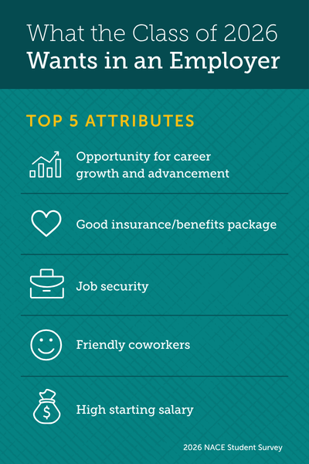
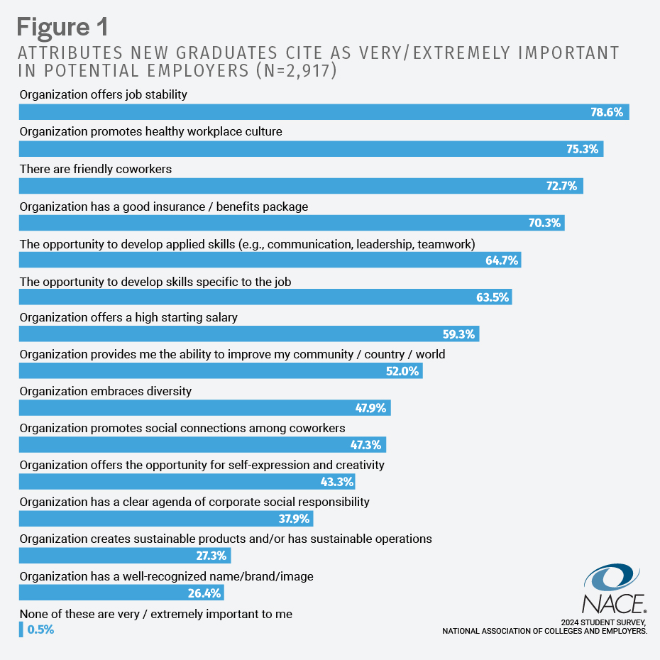
New Grad Wish List ‘25-’26
2025
Notes:
3. How important are flexibility, workplace culture, purpose, and well-being in students’ employment decisions? Very
2025 : Students are seeking job security and healthier workplace culture as key markers when making decisions about job offers
-more students responding negatively to environments that are perceived as toxic; less likely to grin/bear it
2026: Career growth and advancement—still ties to security; they want a clear path for growth in less than 3 years
All info through NACE portal

Slide 13

Recruiting New Graduates
Rotational programs a plus
  Not ideal if too many geographic moves
In-person with flexibility
Cohort experience
Strong manager/supervisor
Access to leadership
Practical skill development or substantive (meaty) projects
Clear mechanisms of support
Notes:
What are the most effective approaches for engaging and recruiting today’s ILR students and recent graduates?
What experiences and development opportunities are students seeking from employers, such as mentoring, rotational experiences, learning programs, and career mobility?

Slide 14

Students’ Impression Of AI In Recruiting & In The Workplace
Notes:
Two different issues---impact on their search and separately impact on the day to day work and the future of work
How are students assessing employers’ use of AI and technology in the recruiting process and workplace?
Two different questions----impact of AI in the search/recruiting process vs. use of AI in the workplace
Employers have indicated a need for AI skills as important but graduating students, Gen Z. are not showing “resistance” in adopting AI though at the same time, they are worried about impact of AI on their job prospects

Slide 15
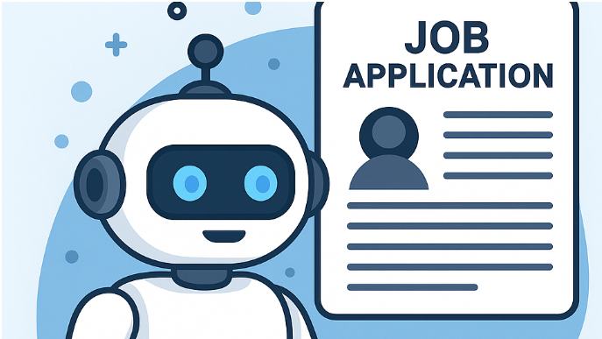
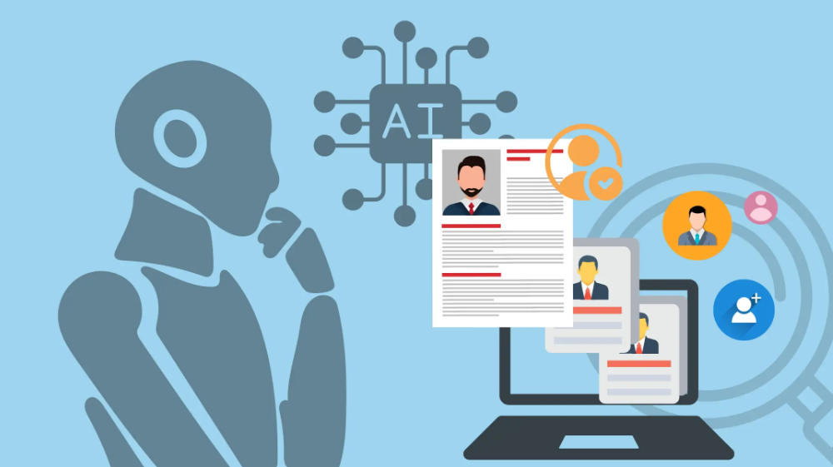

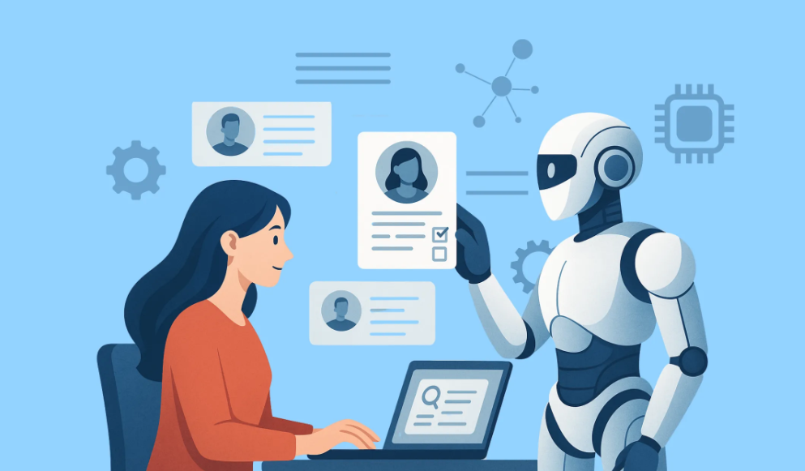
AI in the search process
Notes:
For employers:
Job seekers using AI for resume development, sometimes lying on applications
Bots applying to all the jobs that match = ATS overwhelmed
For orgs. without ATS, general overwhelm for recruiters to source the right folks
Decline of Entry-level roles-software development, customer service, basic data analytics
Behavioral Analysis: Monitoring mouse movements, keystrokes, and other behavioral indicators can help distinguish human applicants from bots.
Bot Detection Software: Specialized software can scan application patterns (e.g., repetitive keywords, rapid-fire submissions) to flag suspicious activity.
Two-Factor Authentication: Requiring candidates to verify their identity via phone or email reduces the success of automated submissions.
Enhanced Captchas: Using advanced captchas that adapt to bot evolution is a frontline defense.
AI Screening Tools: AI can help HR teams analyze application patterns and filter out bot-driven submissions more efficiently.
https://www.linkedin.com/pulse/rise-bots-us-job-applications-implications-employers-seekers-turner-xvj5e/
For employers:
Pros
Efficiency in process
AI screening tools can filter out AI-driven submissions
Saves time in different aspects of recruitment process
Cons
ATS overload
Skewed data/metrics
Security risks
As a result, (next slide)

Slide 16
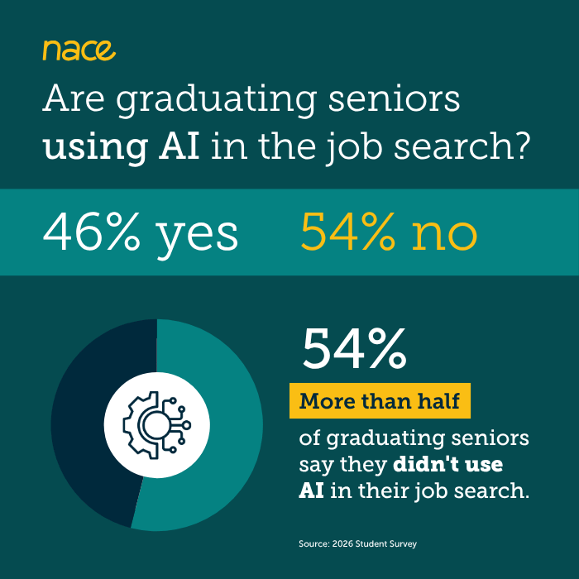
Impact On Student Candidates
Pros
  Efficiency in application process
  Interview Prep/Confidence
  Automated Searches
Cons
  Over-reliance on AI
  Increased competition
  Bias potential
  Rejections for real applicants by employer ATS
  Impersonal engagement (recorded video interviews)
Notes:
https://www.naceweb.org/talent-acquisition/student-attitudes/ai-the-gap-between-employer-expectations-and-student-attitudes
NACE reported that 67% of Class of 2025 respondents indicated NOT using AI in their job search. Mainly due to ethical implication (28.9%); lack of expertise (~25%); employers would know (24.6%)
https://www.naceweb.org/job-market/trends-and-predictions/student-concerns-about-ai-tempering-their-use-of-it-in-job-search
While many students indicated the lack of desire to use AI in their search, those who reported using cited the “pros” indicated.
The Cons contribute to their general stress about a top factor previously mentioned: job stability and security.

Slide 17

Notes:
This is what it feels like for our students---the black hole, the cyber abyss.
This is where networking is critical—engaging in meaningful conversations with employers, recruiters, alumni, peers and leverage the information shared in applications and during interviews.

Slide 18
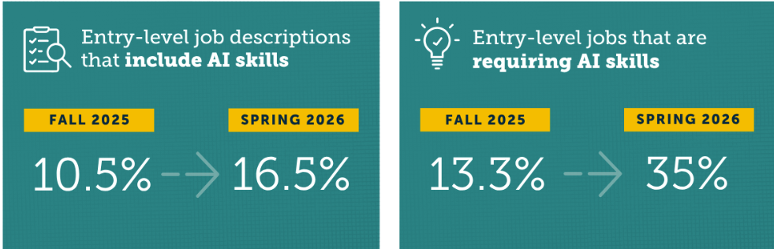
2026 Job Outlook Spring Update
Notes:
How are students assessing employers’ use of AI and technology in the recruiting process and workplace?
Two different questions----impact of AI in the search/recruiting process vs. use of AI in the workplace
https://naceweb.org/job-market/trends-and-predictions/demand-for-ai-skills-in-entry-level-jobs-nearly-triples-since-fall-2025
Employers have indicated a need for AI skills as important but graduating students, Gen Z. are not showing “resistance” in adopting AI though at the same time, they are worried about impact of AI on their job prospects

Slide 19
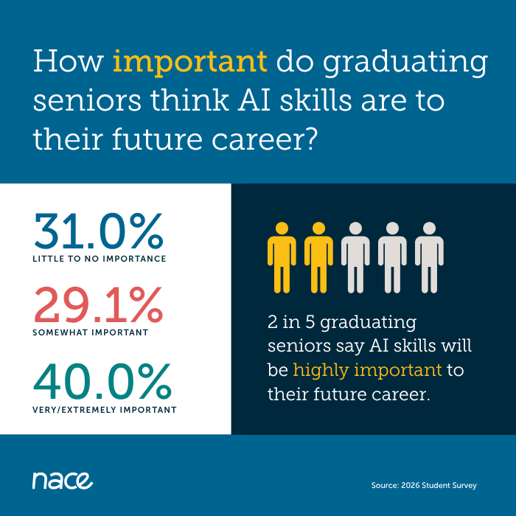
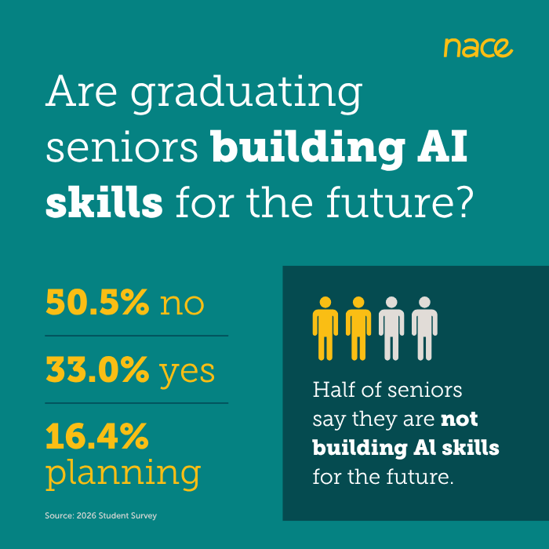
Notes:
https://www.naceweb.org/talent-acquisition/student-attitudes/ai-the-gap-between-employer-expectations-and-student-attitudes
Employers have indicated a need for AI skills as important but graduating students, Gen Z. are not showing “resistance” in adopting AI though at the same time, they are worried about impact of AI on their job prospects

Slide 20

Questions

Slide 21
Discussion – Student Perspective
What are the most effective approaches for engaging and recruiting today’s ILR students and recent graduates?
What experiences and development opportunities are students seeking from employers, such as mentoring, rotational experiences, learning programs, and career mobility?
How important are flexibility, workplace culture, purpose, and well-being in students’ employment decisions?
How are students assessing employers’ use of AI and technology in the recruiting process and workplace?

Slide 22
Upcoming CAHRS Events (with more to come)
Working Groups (virtual and in person)
  CAHRS Virtual Working Group: Campus and Early Career HR Recruitment in the Age of AI | September 3
  CAHRS In-Person Working Group: The Evolving Landscape of Employee Relations | October 28 | ILR NYC Conference Center
  CAHRS Virtual Working Group - HR for HR: Building the Future-Ready HR Function | November 5
CAHRScasts (webcasts)
  CAHRScast Series - AI Applications in Talent Management: Opportunities, Challenges, & Future Directions
  September 23, October 21, and November 18: 1:00-1:30 pm (ET) | View details and Register
Fall Signature Event Dates:
CAHRS Executive Roundtables (in-person)
  September 10-11, 2026 | Ithaca, NY | For more information, visit CAHRS Executive Roundtables Fall 2026
CAHRS Fall Partner Meeting (in-person)
  October 21-22, 2026 | Ithaca, NY | View full program details and register: CAHRS Partner Meeting
CAHRS & Center for Strategic and Human Capital Research Joint Partner Meeting (in-person)
  April 28, 2027 | Taipei |View full program details and register: Joint Partner Meeting
Learn More & Register: ilr.cornell.edu/cahrs/events

Slide 23
THANK YOU
Beth Flynn-Ferry
beth.flynn-ferry@cornell.edu

